Slide 1
Hello Yr5 Please see additional Home Learning tasks.
You do not need to complete all the tasks.

Slide 2
Writing
Write the opening of a story. You can choose if this is a suspense, fantasy
Information text Using your learning from last half term, research a famous person or family member and write and information text about them.
Diary Entry
Write a diary entry from the perspective of a character in the book you are currently reading

Slide 3
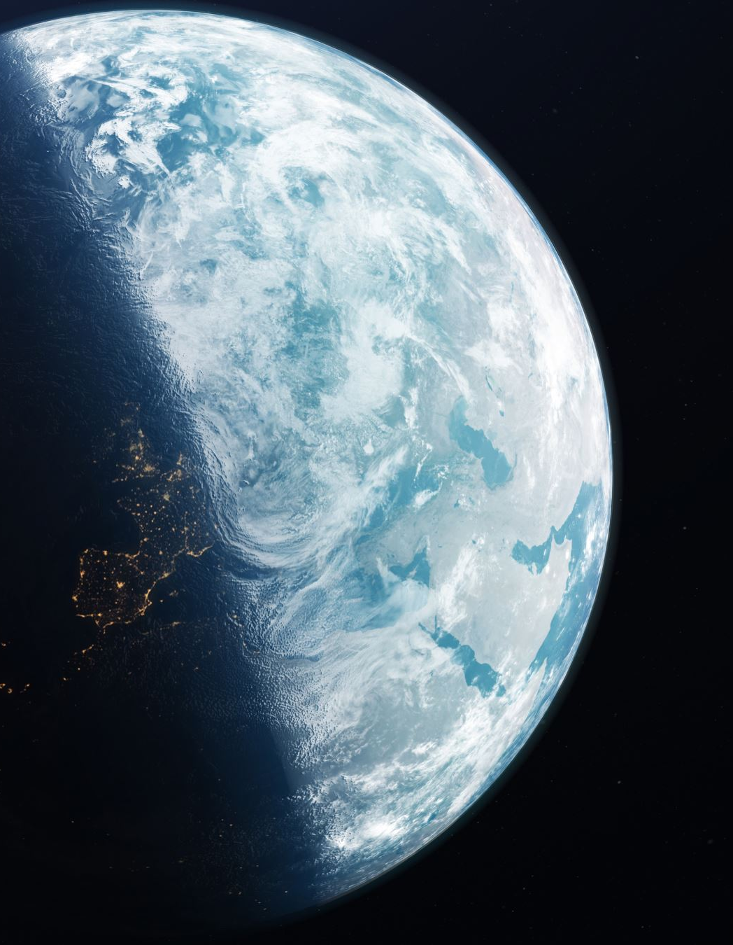
Create a New Planet
Task: Imagine you are an astronaut who has just discovered a new planet. Write a detailed description of this planet, including its name, climate, the type of animals or plants that live there, and how it differs from Earth.
You could include drawings of your planet too.
The Mysterious Door
Task: You find a mysterious door hidden in your school or home. Write a story about what happens when you open it. What do you find on the other side?
Write a Poem About Nature
Task: Write a poem describing a scene in nature. You can describe a forest, beach, mountain, or even a garden. Use sensory details to bring the scene to life.

Slide 4
Reading
Look at the extract 'Listen to the Moon' and answer the questions alongside it.
Read a chapter of your current reading book.
Write 5 questions for either the author of a book you have read, or one of its characters.
Create a fact file about one of your favourite characters from a book you have read.

Slide 5
Create a new front cover for a book you have read.
Compare two books.
Choose two books you've read recently. These could be two books by the same author, two books from the same genre, or two completely different books. It’s important that you have read both books and feel confident in your understanding of them.
Compare the characters, storyline, settings and themes of the story. Which one did you prefer? Why is this?
I

Slide 6
Spelling
Practise some of the year 3 / 4 and 5/ 6 spellings that you find tricky.
You could:
“write” their spelling words in the air with their finger or a pencil. They can do this with one hand or both hands.
Create a spelling pyramid.
Ie -
C
Ca
Cat

Slide 7
Split the words into phonemes.
Put the words into simple sentences.
Rainbow spellings Write each letter in different colour. Repeat this 5 times.
Word Hunt. Can you find any of your spellings in books, magazines or newspapers? Create spelling flash cards for yourself.

Slide 8
Creative Tasks
Creative Task: Design Your Own Magical Creature
Imagine you have discovered a magical creature in a hidden part of the world. Your job is to describe and design this creature, giving it unique features, abilities, and a story. You will then present your creature to the class (or your family) in a creative way!
You will need to:
Name it, draw it, describe it, think about its abilities and powers.

Slide 9
Create Your Own Time Capsule
Imagine you are creating a time capsule that will be opened 100 years from now. You need to decide what to put inside this time capsule to help future people understand your life, interests, and the world around you. You should choose items and explain their significance.

Slide 10
Create Your Own Superhero
Imagine you have the power to create your own superhero. This superhero could have any abilities you can think of—flying, invisibility, super strength, or even something completely unique. Design your superhero, give them a name, and you could write a short story about one of their adventures.

