Slide 1

Hilltop Residential
Monday 2nd March to Friday 6th March

Slide 2
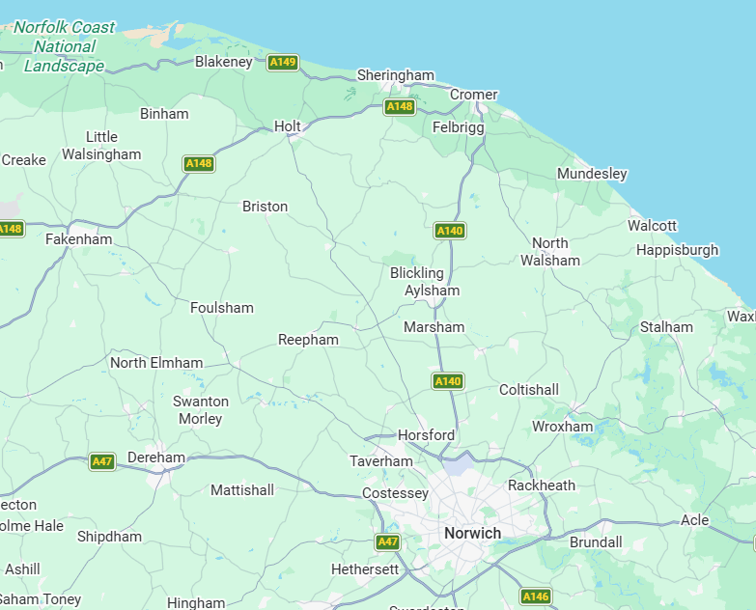

Where are we going?
Hilltop Outdoor Centre is approximately 2 hours away in Sheringham, North Norfolk.

Slide 3

Hilltop Centre
Hilltop Outdoor Centre was founded over 30 years ago by the Read family. What began as a small, vision-driven project has grown organically over the years into a highly regarded outdoor education provider, welcoming hundreds of school groups each year for memorable residential experiences.
Set within 26 acres of stunning woodland on the picturesque North Norfolk Coast, Hilltop offers an inspiring natural setting for learning, adventure, and personal development. As a proudly independent, family-run centre, Hilltop blends high-quality facilities with a warm, personal approach that puts visitors at the heart of everything it does.
Dedicated to delivering exceptional, confidence-building experiences for schools, Hilltop has earned the nationally recognised Learning Outside the Classroom Quality Badge. The centre offers an extensive programme of outdoor adventure, team-building challenges, and hands-on discovery and field study sessions—carefully designed to support curriculum learning, wellbeing, and life skills.
Accommodation and activity spaces are split between two thoughtfully themed bases: the cosy, forest-inspired Woodland Lodge centre and the bright, coastal-style Seaview House centre. Together, they provide safe, comfortable, and characterful environments in which visiting children can relax, explore, and thrive.

Slide 4
Who is going?
Mrs Barton
Mrs Talbot
Mrs Landeryou/ Mr Carter
Mrs Silvester
Mrs Bradley-Jones
Mrs Curliss

Slide 5
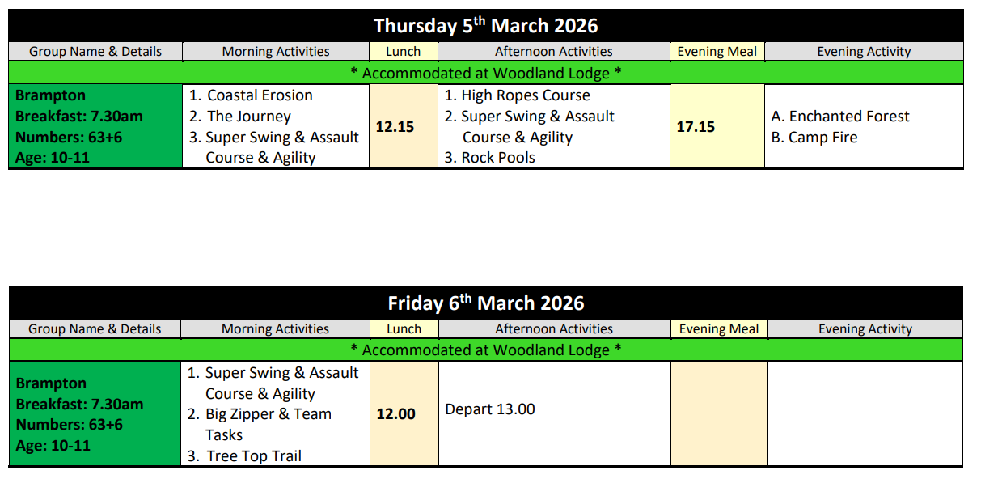

Activity Timetable

Slide 6
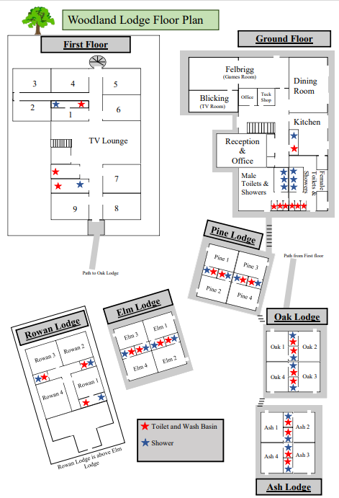

Accommodation
We have been allocated:
Woodland Lodge
Rowan Lodge
Elm Lodge

Slide 7

Menu for the week:

Slide 8
Routine:
Wake-up: 07:00
Breakfast: 07:30
Morning Activity
Lunch: 13:00
Afternoon Activity
Dinner: 17:15
Evening Activity
Bedtime: 21:00

Slide 9

keep all rooms tidy
behave sensibly whilst in their rooms
always walk inside the accommodation block
enter only your dormitory
use good table manners at mealtimes
say only positive things or say nothing
show good manners at all times
not shout or use bad language
respect other peoples’ property
show consideration for everyone
readily follow instructions given by an adult
stay with the group and not wander off
The aim is to preserve the good name of the school and to ensure all pupils behave in an acceptable and courteous manner.
Following this code will ensure a happy and successful visit for all.

Slide 10
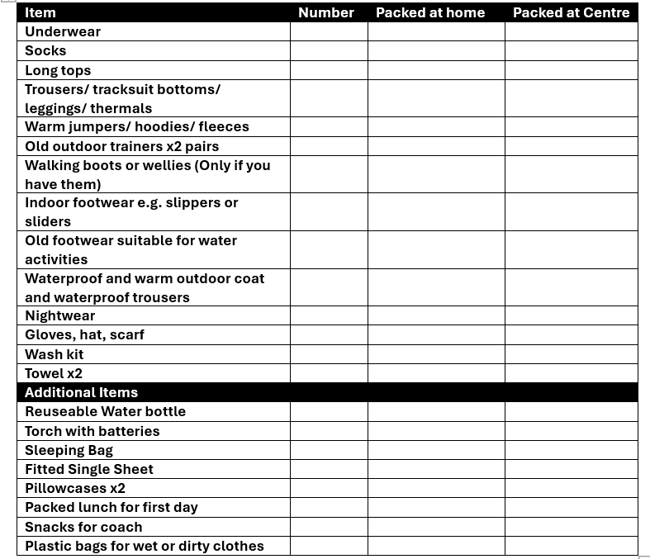
Kit List

Slide 11
Non-Negotiables:
IMPORTANT INFORMATION:
Please do not bring:
mobile phones or any other electrical devices.
money or any valuables
Food and drinks apart from snacks on the coach and lunch for day 1
No aerosols or aerosol deodorant
No nut or nut products

Slide 12
Arrive at school: Monday 2nd March - 7.45am
Bring a snack, packed lunch and reuseable, named, water bottle with drink in a backpack.
Bring a book / Top Trumps etc. to play on coach.
Medication – Must be in original container with written instructions, named) and be handed in on arrival.
Luggage (1 Bag) including Bedding (sleeping bag, single sheet and 2 pillowcases)
If it is not raining, please leave luggage outside next to mural to be loaded directly onto coach
No Valuables / No Money/ No electronic devices
Day of Departure

Slide 13
Further information
Hilltop Outdoor Centre Website:
https://www.hilltopoutdoorcentre.co.uk/

Slide 14

Any questions

