Slide 1
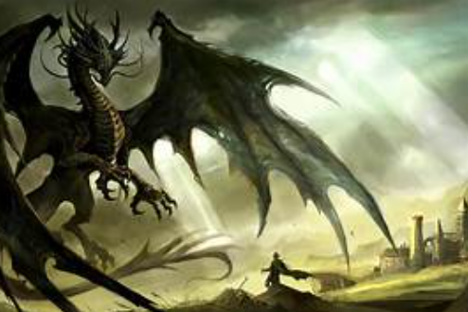
Warm-Up: Story Time
Write a short 'defeat the monster' story.
It can be a Five Sentence Story.
Additional challenge: Include correctly
punctuated dialogue!
Once there lived...
Early one morning...
Unfortunately...
Luckily...
Finally...

Slide 2
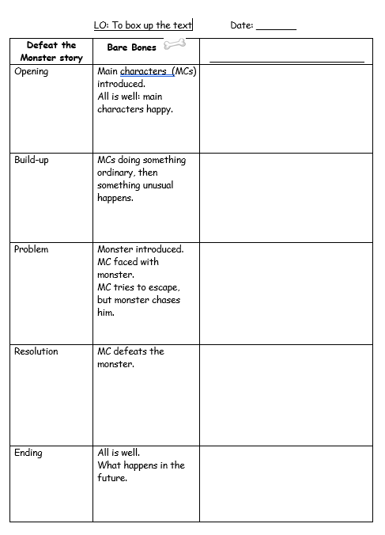
Today we are going to brainstorm ideas for a new version of Jack and the Beanstalk.
You will work in pairs to share ideas and complete the Boxing Up grid.
Your ideas must work well together and the story must flow well.
Decide:
Who are the main characters?
What happens in the build-up?
Who is the monster?
How does the main character meet the monster?
How does he defeat the monster?
What happens at the end?
There are some monster ideas on the next slide…

Slide 3
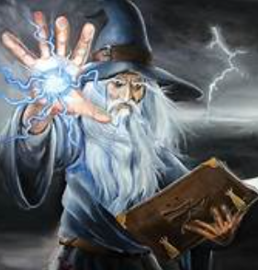
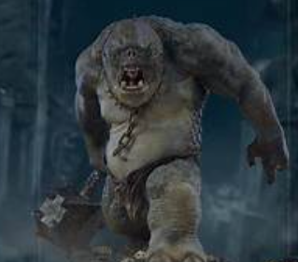
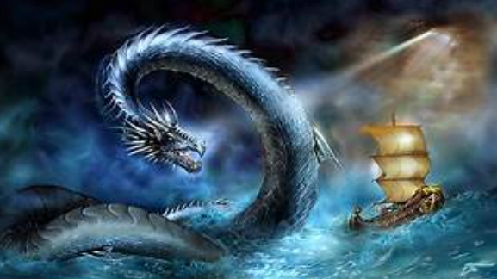
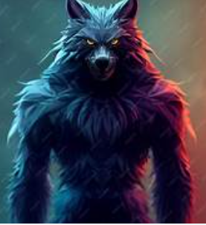
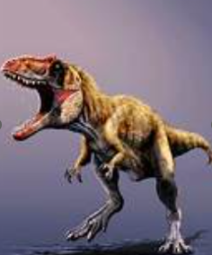
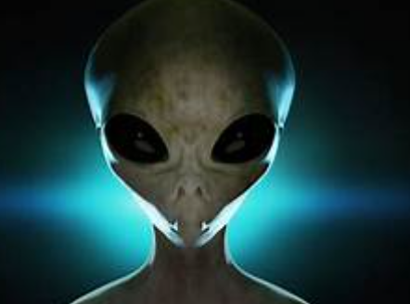
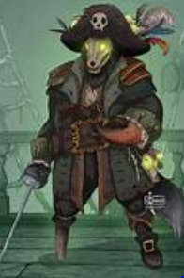
Some ideas for a monster…
wizard
troll
sea serpent
pirate
dinosaur
alien
werewolf

Slide 4
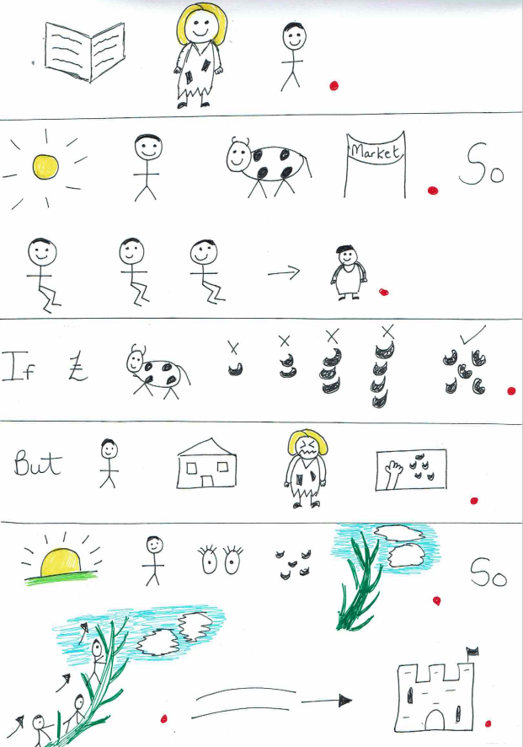
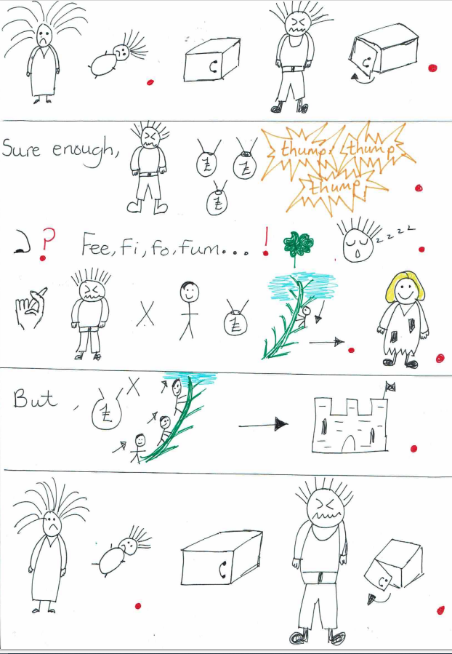
Plenary
Rehearse the
model text.

Slide 5
