Slide 1
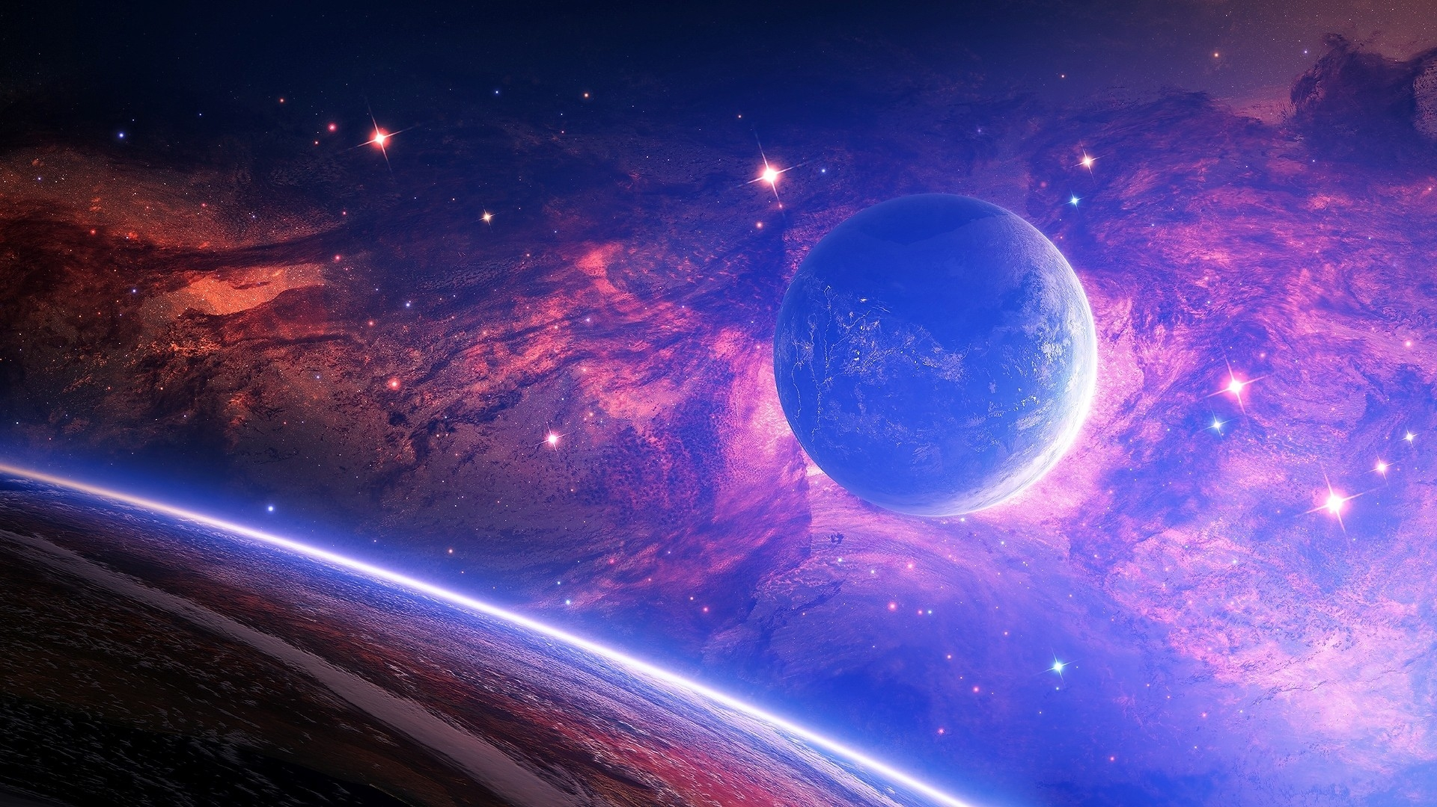
Our new Science topic is:
Earth…
and Space

Slide 2
LO: To research information about the Sun.
Task Using a variety of sources (video clips, information texts etc), research and collect facts about the Sun in your Science book.

Slide 3
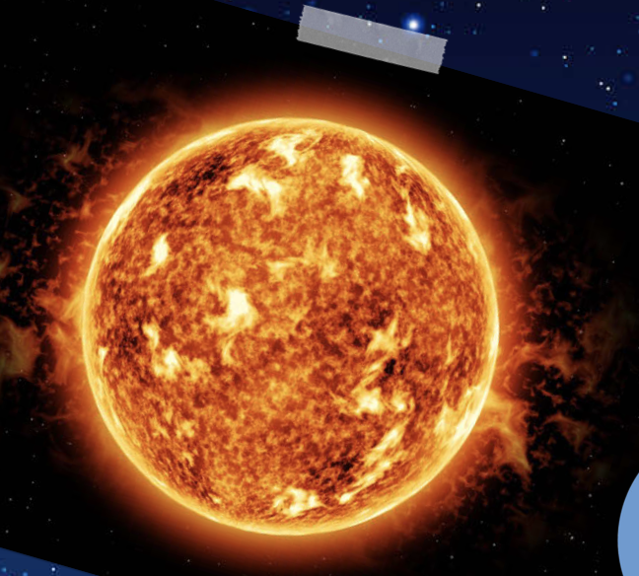
Sun
The Sun is at the centre of our solar system. It is a star made of burning gases. It burns at over 5000°C which provides the solar system with light and warmth.
The light from the Sun only takes eight minutes to travel the 149.6 million km to Earth!

Slide 4
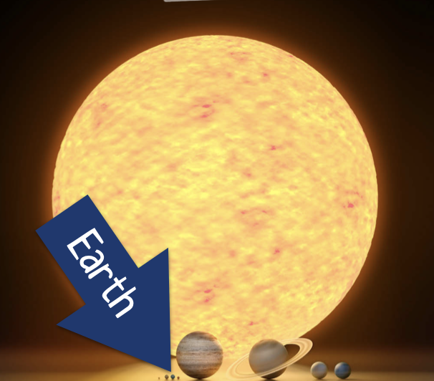
roughly spherical: adj. roughly shaped like a ball
The Sun is the biggest object in our solar system. It makes up 98% of the total mass!
The Sun has a roughly spherical shape which is about 1,400,000 km in diameter. Earth has a diameter of just over 13,500 km. This means the Sun could fit 1,300,000 Earths inside it!

Slide 5
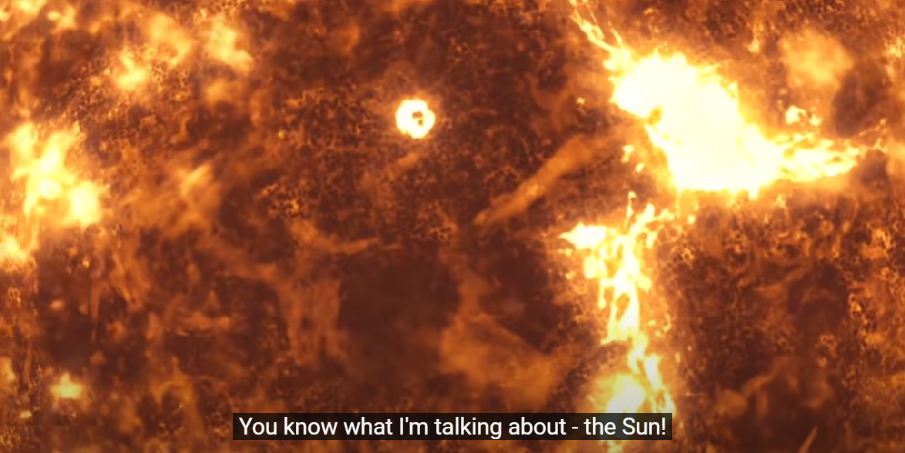
Video clip:
Watch the video link and collect facts about the Sun on a whiteboard.

Slide 6
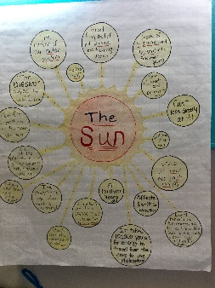
LO: To research information about the Sun.
Now, record the facts you’ve collected into your Science book, displaying them in whatever way you’d like.
For example:

