Slide 1


Slide 2
Y4 Times Tables
Parent meeting

Slide 3
Agenda
What is the MTC?
TTRS games for learning
TTRS games for testing
Other ways to learn
Questions

Slide 4
What is the MTC?
A government check on times tables recall which takes place in year 4
25 questions that children have 6 seconds to answer using a laptop
Adaptations can be made for some children – speak to class teacher
For children to continue making expected progress, they should know most of their times tables by the end of year 4 (up to 12x12)

Slide 5
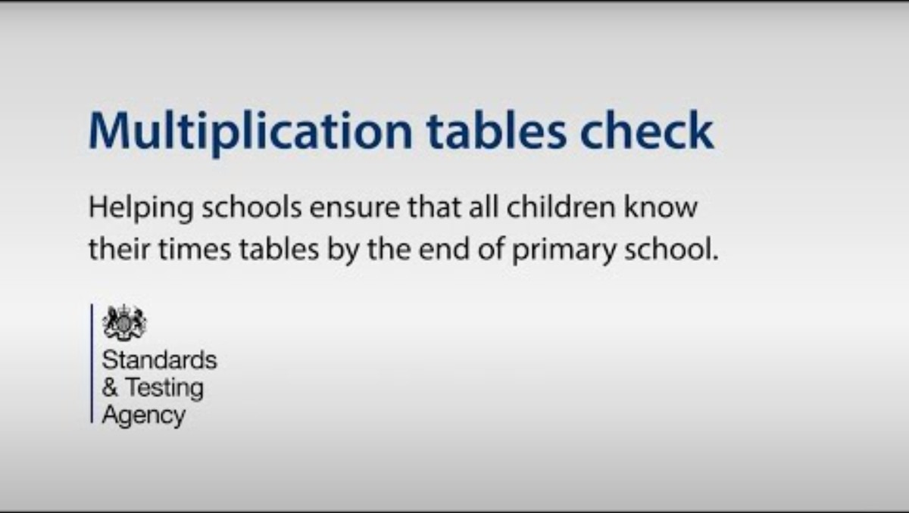
Multiplication tables check: information video

Slide 6
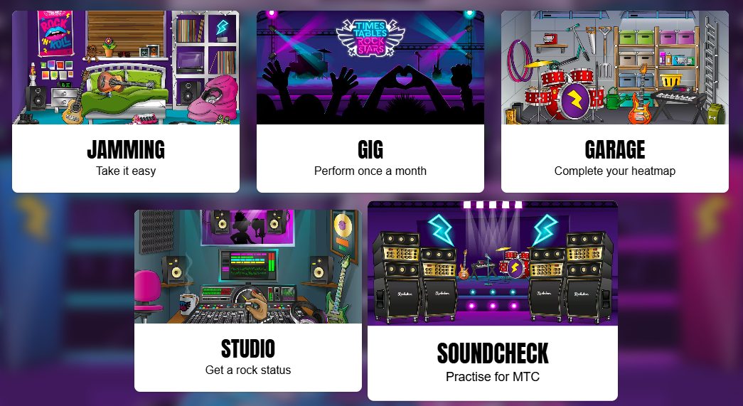
TTRS for learning
Garage
You can see your heatmap
It will ask you the questions you need to complete your heatmap
We will send heatmaps out every half term so you can also see the progress
Jamming
You choose the tables you know you need to work on
Focus most TTRS time on these games.
5 minutes per day

Slide 7
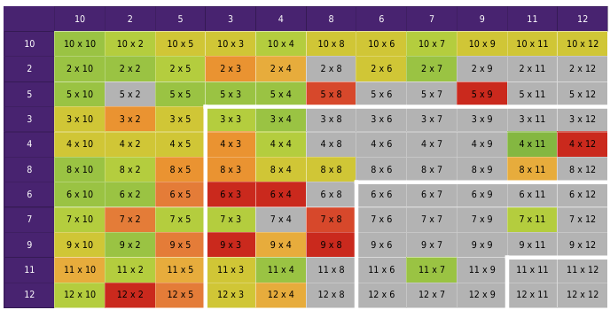
Heatmap

Slide 8
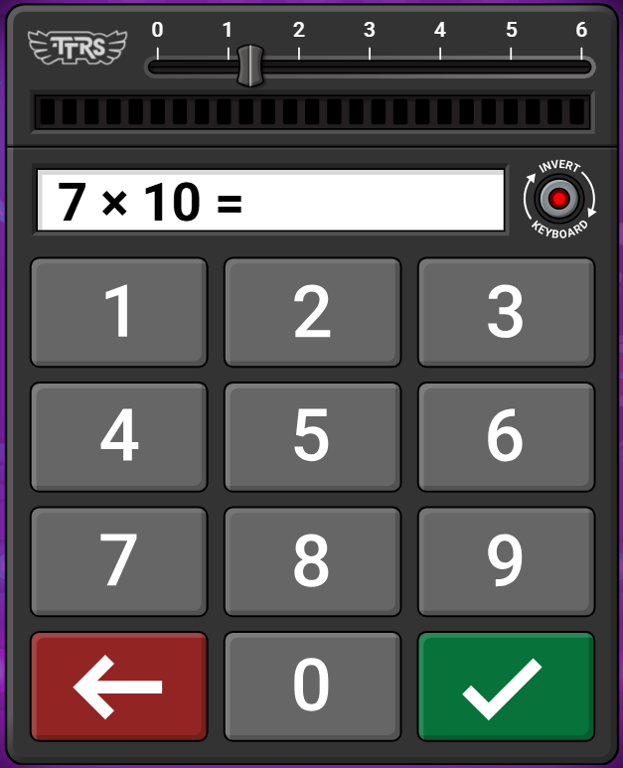
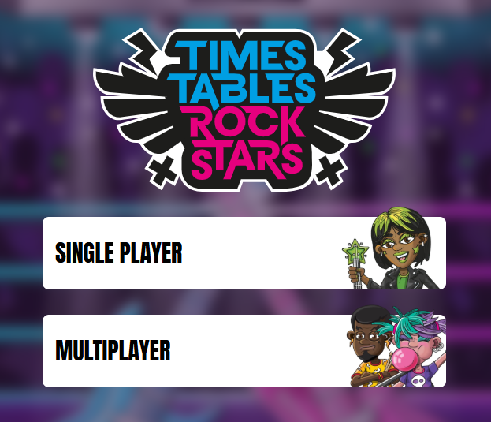
TTRS for testing
We recommend children type in their answer and then wait for the timer to end.
Their answer will still be counted and it will give them a moment to breathe before the next question, or check that the answer they typed is correct.
ONLY 1 per week.

Slide 9

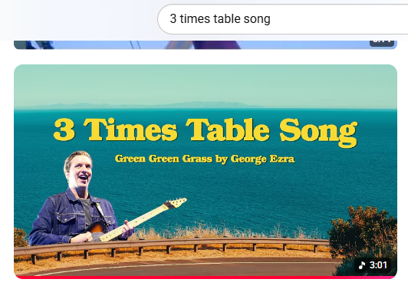
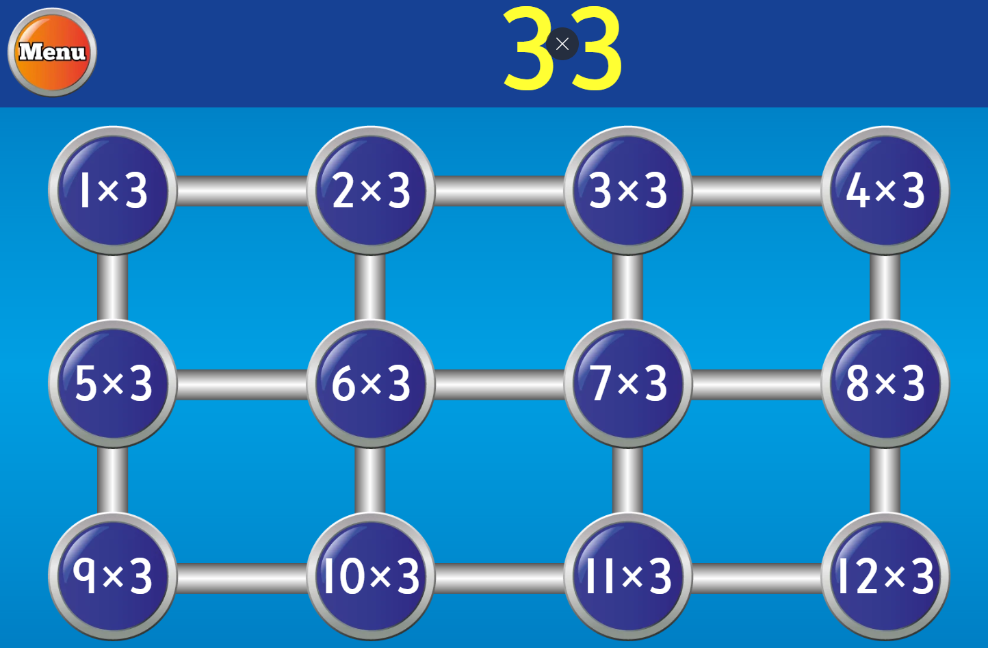
Other ways you can learn…
Youtube
If you search times table songs on YouTube, you will find catchy songs that support children to remember their times tables. Some songs are better than others, so choose the ones you prefer!
Verbal recall
Times tables can be practised anywhere at any time! E.g. in the car, making dinner, walking to school etc.
Begin by counting in multiples.
“3, 6, 9, 12, 15 ...”
Then, move onto recalling times table facts.
“1x3=3, 2x3=6, 3x3=9...”
“Four times three is twelve”
“Four lots of three is twelve”
Then move onto testing their fluency. If you ask them for a times table, can they answer quickly?
hit the button
This is a game children can access via Brampton Apps. It does not require a login.

Slide 10
Questions?
Thank you,
Year 4 Team ☺

