Slide 1
Explain the relationship between multiplying a number by 10 and multiples of 10
Task A: 10 times as many
1) Complete the missing numbers below.
___ × 10 = 0
1 × 10 = ___
2 × 10 = 20
3 × 10 = 30
___ × 10 = 40
5 × 10 = ___
6 × 10 = 60
0
10
7 × 10 = ___
8 × 10 = 80
9 × 10 = ___
___ × 10 = 100
11 × 10 = 110
12 × 10 = ___
70
90
4
10
50
120
2) Complete the diagrams below that describe the representations of pencils.
4
a)
___ × 10 = 40
40
4
10 times the size
___
10 times as many
5
b)
___ × 10 = 50
___
50
5
10 times the size
10 times as many

Slide 2
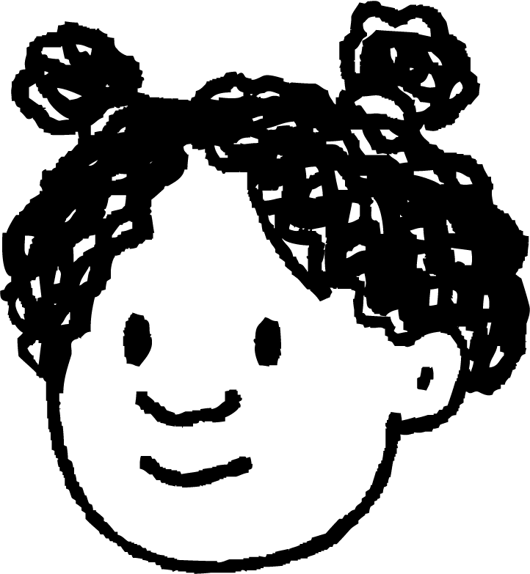
Explain the relationship between multiplying a number by 10 and multiples of 10
3) Which of the characters below do you agree with? Explain your reasoning.
To find 10 times as many of something, you have to multiply it by 10
To find 10 times as many of something, you have to count up in tens that number of times.
Both characters are saying similar things here. Andeep is using tens as the group size in a multiplication whereas Izzy is using 10 as the number of groups.
Task B: Multiples of 10
1) Sort these numbers into the correct column
according to whether they are a multiple of 10 or not.
1
4
15
200
42
208
30
Multiple of 10
Not a multiple of 10
200
These have 0 as the ones digit.
1
42
30
4
208
15
2

Slide 3
Explain the relationship between multiplying a number by 10 and multiples of 10
2) Complete the table by deciding true or false.
 | Multiple of 10:
30
130
103
1,000
1,020
true
( )
or false
( )
103 has a 3 in the ones digit. Multiples of 10 have zero as a ones digit.
3) Using all four cards each time, how many different multiples of 10 can you make?
0
1
2
3
1,230
2,130
3,120
1,320
2,310
3,210
The 0 will have to be the ones digit for every number, multiples of 10 always have a zero as a ones digit.
Then we can systematically work through the other digit combinations, starting with 1 in the thousands column and then swapping 2 and 3
4) Do you agree with Andeep? Explain your answer.
I disagree. Numbers only need a 0 as the ones digit but they can have a 0 in other place value columns too. Below are some examples of numbers that are multiples of ten but also have a zero in the tens column.
Multiples of ten always have a digit greater than zero in the tens column.
100
200
300
Mathematics in Education and Industry.
v2.3

